Slide 1
From Verilog To DEF
Hossam Elsamanoudy

Slide 2
Outline
Physical Design Flow:
NetList
Floor Planning
2. DEF File Format
3. Project Achievements
4. Testing the DEF file

Slide 3
Netlist
first stage in physical design flow is reading in the netlist and the constraints
It’s divided into:
Gate Level Netlist
Standard Cell Library
Technology File
Timing Constraints

Slide 4
Netlist:: Gate Level Netlist
synthesis tool is used to translate RTL into a collection of interconnected logic gates that define the logic
The most common format is verilog.
Some tools like the one done in this project internally uses some other library like Yosys to generate a json file and parse it instead of the actual verilog file

Slide 5
Netlist:: Standard Cell Library
Layout Model:
Is abstract model of the standard cell layout is used instead of the complete layout
Has PINs defined, so as to facilitate automatic routing by the tool as per your netlist.
This makes sure that the interconnection between the PINs can be routed automatically and that the routing tool will not route over existing metal/via areas thus ruling out any shorts
LEF is an ascii file, such files have the PINs and Obstructions (blockages) defined, so it can be used here.
2. Timing Model:
A a timing model is in the form of a .lib file
It could also be a .db file, which is generated from a .lib.
This liberty format file will have timing numbers for the various arcs in a cell, generally in a look up model, and may also have cell power information.

Slide 6
Netlist:: Technology File
The rules pertaining to the selected process should be given to the PnR tool (or simply to the soft floor planning tool presented here in the project). This includes metal widths, spacing, via definitions etc
Mainly in a form of a technology LEF file.

Slide 7
Netlist:: Timing Constraints
SDC files define the timing constraints of the design
It includes clock definitions, false paths, any input and output delay constraints etc.

Slide 8
FloorPlanning
the first major step in getting a layout done
determines your chip quality
define the size of your chip/block, allocates power routing resources, place the hard macros, and reserve space for standard cells
subsequent stage like placement, routing and timing closure is dependent on how good the floorplanning step is.
Includes the following iterations for best floorplanning:
Core Boundary
IO Placement/Pin Placement
Macro Peplacement
Creating Power Rings and Straps

Slide 9
FloorPlanning:: Core Boundary
Floorplan defines the size and shape of your chip/block.
top level digital design will have a rectangular/square shape, whereas a sub block may have rectangular or rectilinear shapes.
Core boundary refers to the area where standard cells and other IP blocks will be placed.
Power routing spaces may also be allocated outside the core boundary.
For a full chip, There should be IO buffers and IO pads placed outside the core boundary.

Slide 10
FloorPlanning:: Core Boundary (Cont’d)
6. floorplanning can be controlled by various parameters::
Aspect ratio: the ratio of height divided by width; determines whether you get a square or rectangular floorplan; An aspect ratio of 1 gives a square floorplan.
Core utilization: Core utilization = (standard cell area + macro cells area)/ total core area); i.e. A core utilization of 0.8 means that 80% of the area is available for placement of cells, whereas 20% is left free for routing.
Boundary: this can come in handy when there exists a boundary from a previous version. When Boundary is the control parameter, both aspect ratio and core utilization are irrelevant.

Slide 11
FloorPlanning:: IO Placement/Pin Placement
We need to place IO pads and IO buffers of the chip
Take a rectangular or square chip that has pads in four sides.
the sides and relative positions of the PADs may be given by the designers.
will also get a maximum and minimum die size according to the selected package
Doing a digital block, requires you to place pins around the boundary to connect to the higher level routing.
a DEF file or a custom floorplan file is used to do this.

Slide 12
FloorPlanning:: Macro Placement
After having the size & shape of the floorplan ready and initialized the floorplan, thereby creating standard cell rows, it’s time to place the macros
Flylines in the design tool can show the connection between the macros and standard cells or IOs:
Use flylines and make sure to place blocks that connects to each other closer
For a full-chip, if hard macros connect to IOs, place them near the respective IOs
Consider the power straps while placing macros. It is possible to club macros/memories

Slide 13
FloorPlanning:: Creating Power Rings &Power Straps
decide on the trunks that supply power to the core.
make sure that all the hard macros have sufficient rings/straps around it to hook into the PG trunks
a robust power structure will take iterations and IR drop analysis at a later stage, but a close approximation can be arrived at the initial stages.

Slide 14
DEF File Format
Design Exchange Format (DEF) is an open specification for representing physical layout of an integrated circuit in an ASCII format.
represents the netlist and circuit layout.
used in conjunction with Library Exchange Format (LEF) to represent complete physical layout of an integrated circuit while it is being designed.
was developed by Cadence Design System
usually generated by place and route (P&R) tools
used as an input for post analysis tools, such as extraction tools or power analysis tools.

Slide 15
Project Achievements
It outputs the def file format with the following sections included:
Header
Rows
Tracks
Vias
Components
Pins
Special Nets
Nets

Slide 16
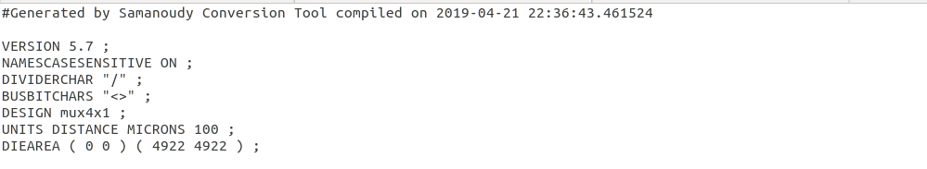
Project Achievements:: Header
All the lines untils design name are extracted from lef file
Design name is the same as top level module in provided verilog file
Units microns are placed by default to be 100 and all the values extracted from lef file use this new microns unit.

Slide 17
Project Achievements:: Header (Cont’d)
Die aea is calculated as the following:
Make sure that width/height always satisfy aspect ratio
Coordinates are specified by the summation of all areas of used cells divided by the core utilization factor
Bottom x,y coordinates are assumed to be 0 if no horizontal or vertical margins are provided.
If horizontal and vertical margins are provided, they are used rather than the core utilization factor to determine coordinates (still aspect ratio is respected here)

Slide 18
Project Achievements:: Rows
The number of rows is determined by the following:
Each cells are grouped together in they have the same site type (e.g. core or corner)
The heights of each group is all summed together
The value we got in b is divided to the cell height of the same site type to determine the number of rows for each site type
In the tested examples attached, all sites are just site core with cell height of 20 unit according to the LEF file.

Slide 19

Project Achievements:: Tracks
Each metal layer has tracks
Orientation of tracks follows the orientation of their metal layers (i.e. Y if horizontal or X if vertical)
The starting point of each track is assumed to be either the bottom x point of the die or the bottom y point of the die according to the orientation X or Y respectively.
Each metal layer has a number of tracks according to the pitch parameter defined in lef file (the number of tracks= the total width of the die/ pitch of the layer) if the orientation is X(vertical) OR (the number of tracks= the total height of the die/ pitch of the layer) if the orientation is Y(Horizontal); This number is typed after ‘DO’ in the format.
The pitch parameter is the one after ‘STEP’ keyword in the output DEF file

Slide 20
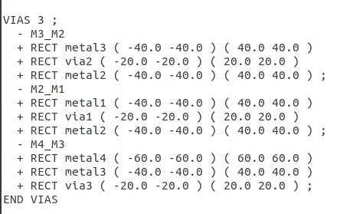
Project Achievements:: Vias
The information for the entire section of VIAS is just extracted from the LEF file with the same x,y coordinates that are also mentioned in the DEF file.
Such section is optional to be included in the DEF file as its is just redundant to what is already provided in the LEF file.

Slide 21
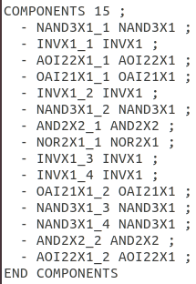
Project Achievements:: Components
All the components are extracted from the GL Netlist provided by Yosys in json format.
All components are mapped to ones from Standard Cell library which the user provides as input to the tool
No placement information is provided here because the tool has no information about it.

Slide 22
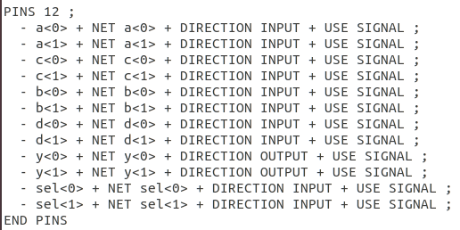
Project Achievements:: Pins
The pins section is also extracted from GL Netlist
The section defines all the bits for each input or output port in the design
Direction of each port is also defined as can be seen
No placement information is provided here because the tool has no information about it.

Slide 23
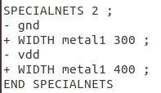
Project Achievements:: SpecialNets
The tool always assumes that both gnd and vdd signals are special nets because this could be helpful for routing in next steps of the design flow
Information about the metal layer of each special net and the ring width is provided by the user and added to this section.

Slide 24
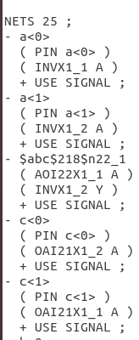
Project Achievements:: Nets
This section provides information about each net in the design (internal or external ones) with all the cells connected to it. Such information is extracted from GL Netlist.
If the net is external (actually a port) then the net is connected to a pin of the same name and also to a cell (e.g. look at the a signal in this figure)

Slide 25
Testing the DEF file
Tested on four designs mux4x1, uart, half_adder, and round_robin_arbiter (can be found in tests directory).
The output def file was read correctly and verified using Glade IC Layout Tool. The following slides show the image of layout provided by Glade for each cell.

Slide 26
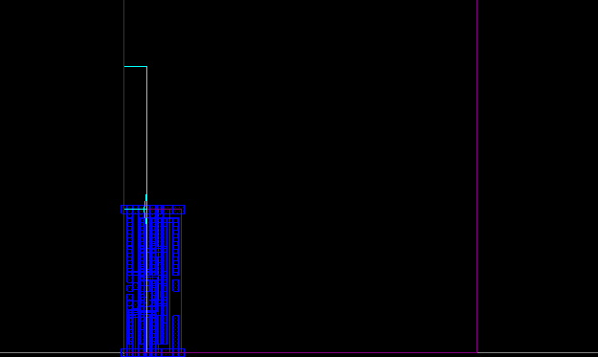
MUX4x1 Layout

Slide 27
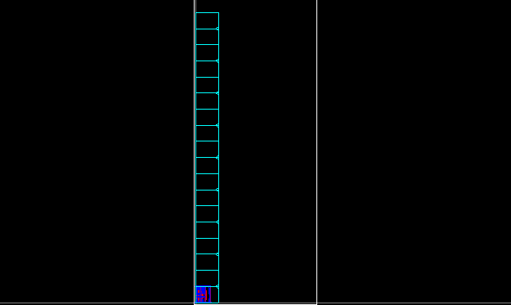
UART Layout

Slide 28
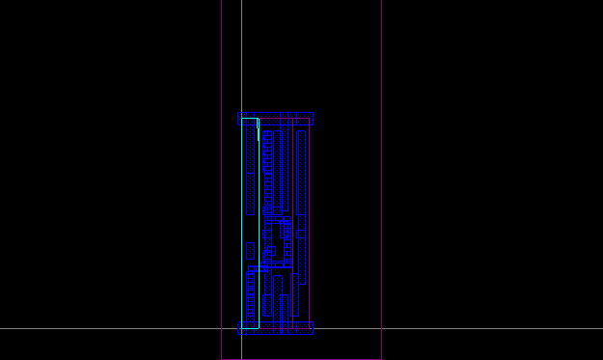
Half_Adder Layout

Slide 29
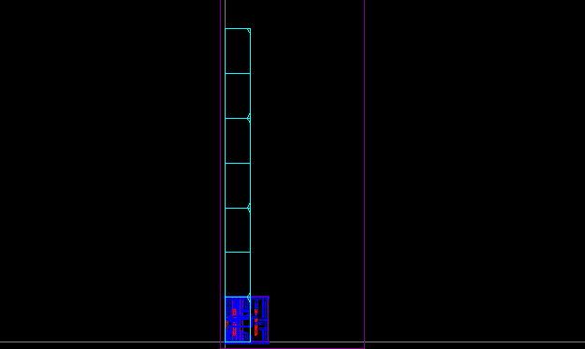
Round_Robin_Arbiter Layout

